Slide 1
Context Sensitive Systems Sensors
SS 2016
teco.kit.edu, pcs.tm.kit.edu
Michael Beigl, Till Riedel

Slide 2
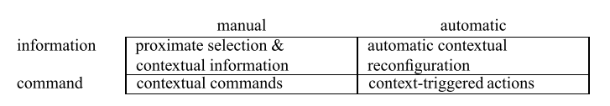
Recap: Schillit’ classes of context-sensitive applications
Dimension 1: Is the adaption done automatic or manual?
Dimension 2: Does the application adapt information access or perform actions?
Task: Two Examples per Class: 10 min break!
Trigger
Output
Manual /explicit
automatic/implicit
Information access
Command execution

Slide 3
Content of this lecture
Context and Motivation
Sensors and Middleware
/ 8. Features in Data
/ 9. Prediction
/ 10. Classification
Vertical Application
Fusing Knowledge
Context oriented Programming

Slide 4
Sensors

Slide 5
Sensors: Motivation
Human Sensors as a model:
Quantity:
Multiple sensors provide the feedback to a human to make him „smart“ (to learn, to have redundant sources for a signal etc.)
Sense | Human Organ | Quanitity | Sensor | Physical
Hearing | Ear | 3* 10^4 | Microphone | Sound
Seing | Eye | 2* 10^8 | Photo detector | Light
Smell | Nose | 10^7 | Gas | Gas
Feeling: Warm Feeling: Cold Feeling: Pressure Feeling: Pain | Skin | 10^4 10^5 5*10^5 3*10^6 | Thermo element Thermo element Piezo | Heat Cold Pressure

Slide 6
Human Senses
Aristoteles five sense definition
sight, hearing, touch, smell, taste
Additional senses
nociception (pain),
equilibrioception (balance),
proprioception & kinesthesia (joint motion and acceleration),
thermoception (temperature differences)

Slide 7
Sensors

Slide 8

Motivation Context through Sensors
Sensor Enable new interactions by providing context
Tilt sensor→ Orientation
Light sensor→ LCD Brightness
Albrecht Schmidt, Michael Beigl, Hans-Werner Gellersen:
There is more to context than location, 1998

Slide 9
Sensor Development
Accelleration
Light
Proximity
Touch
Camera
GPS
Rotation
Temperature
Compass
Notes:
Das HD2 verfügt über einen GPS-Empfänger, einen Näherungs-, Beschleunigungs- und Lichtsensor + Micro + Kamera + touch= 7, davon 2 komplexe
2002: first commercial camera phone complete with infrastructure was the J-SH04, made by Sharp Corporation, had an integrated CCD sensor, with the Sha-Mail (Picture-Mail in Japanese) infrastructure developed in collaboration with Kahn's LightSurf venture, and marketed from 2001 by J-Phone in Japan today owned by Softbank. The first commercial deployment in North America of camera phones was in 2002.
2007: iPhone 2G: Accl, proximity, micro, kamera, touch = 5

Slide 10
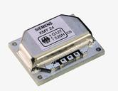

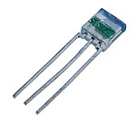
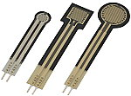

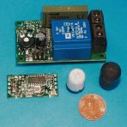
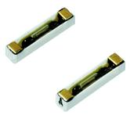
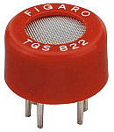
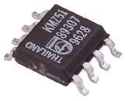
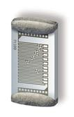
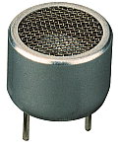

Sensor Examples
So many types...
How to classify?

Slide 11
Sensor classification by measure
Direct Physical Measures (SI)
length, mass, time, electrical current, temperature, molar amount, luminosity
Derivatives
angle, velocity, frequency, force, momentun, energy, pressure, load, voltage, tension, power,…

Slide 12
sensor classification by active principle
Electrical measurement of capacity, inductivity, charge, resistance....
passive: generating voltage
Converting mechanical, chemical, photonic or thermal energy
Examples: Hall effect, piezo effect, …
active: needs energy
„probes“ changes of a non-electrical influence using generated signal
Change in resistance, inductivity, capacity

Slide 13
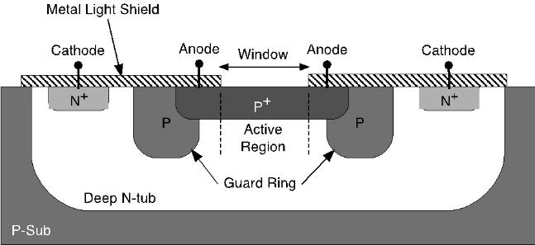

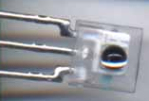
Semi conductors
CMOS sensors
arrays & matrices form video sensors
Sensing context from light:
Reconstructing Images
Intensity
Lightspectrum
Movement
„Codes“: 50Hz/100Hz
→ Low energy consumption

Slide 14
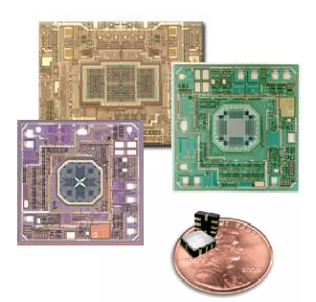
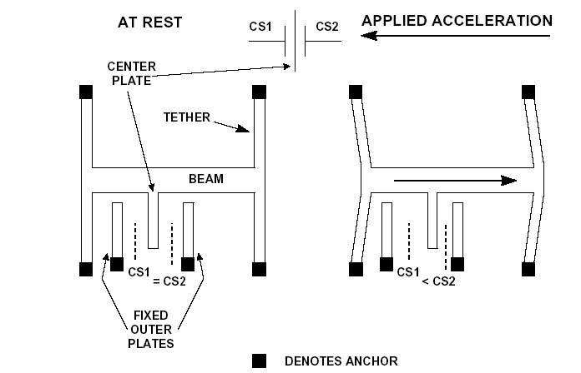
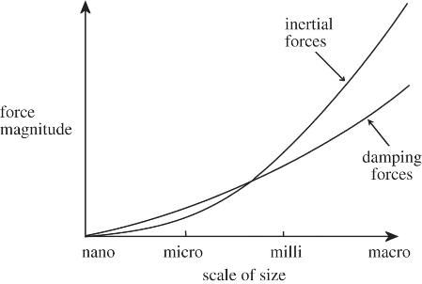
MEMS Principle
MEMS =
Micromechanical System Mechanics directly in silicon
Smart Systems

Slide 15
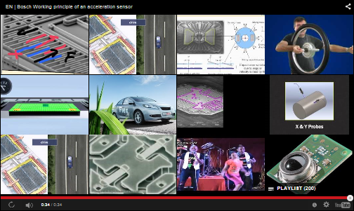

Slide 16
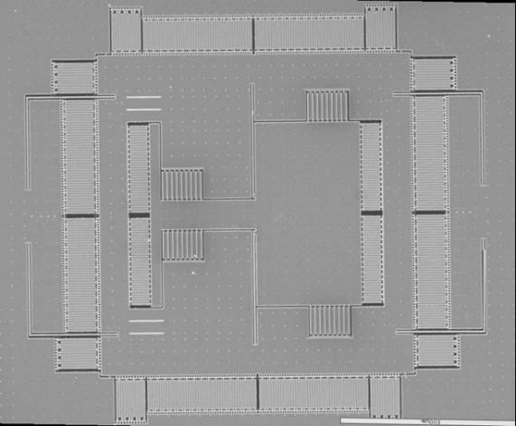
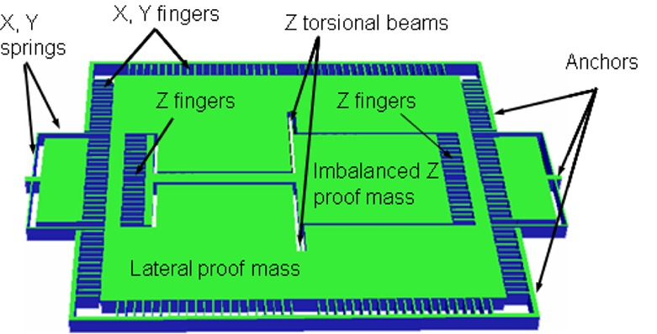
3D model of the 3-axis CMOS-MEMS accelerometer
SEM of a fabricated 3-axis SCS accelerometer

Slide 17
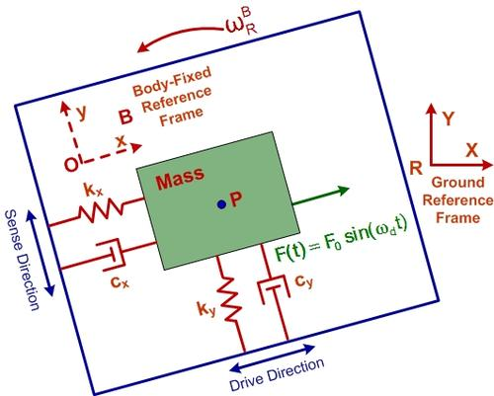
MEMS Examples
Gyroscopes
Magnetometer
Barometer
Hygrometer
Ultrasound transducers
MEMS gyroscope
Source: http://www.designnews.com/author.asp?doc_id=256404

Slide 18
Measurement

Slide 19
Definition transducer
A transducer is a device that converts one form of energy to another form of energy. Energy types include/(but are not limited to) electrical, mechanical, electromagnetic (including light), chemical, acoustic, and thermal energy. (for example, a loudspeaker converts an electric signal to sound),
A sensor is a transducer whose purpose is to sense (that is, to detect) some characteristic of its environs. A sensor is used to detect a parameter in one form and report it in another form of energy, often an electrical signal.

Slide 20
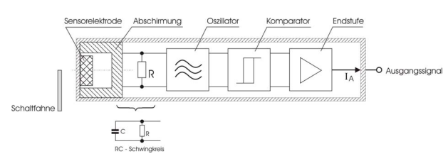
Capacitive Sensor
Sensor typically includes RC element
Capacity introduces either damping or frequency change

Slide 21
Classical Pattern Recognition
Data come from a transducer
Feature extraction compresses, filters, transcodes, prepares sensor data
Classification interprets features and assigns a class for them (Knowledge required!)
Further abstraction may be added: high level information, reasoning
Sensor
Data
Class
Feature
Extraction & Reduction
Features
Detection (Transducer)
Further Abstraction
Classification
...
...

Slide 22
Analog / Digital
In our case: the input to the feature extraction process should be digital. This means there is an Analog/Digital (A/D) conversion in the end of the chain.
WHY not just sensing digital?

Slide 23
Analog / Digital
In our case: the input to the feature extraction process should be digital. This means there is an Analog/Digital (A/D) conversion in the end of the chain.
WHY: Because reality is analog.
What is the consequence of the world being analog in terms of measurement accuracy?

Slide 24
Analog / Digital
In our case: the input to the feature extraction process should be digital. This means there is an Analog/Digital (A/D) conversion in the end of the chain.
WHY: Because reality is analog.
What is the consequence of the world being analog in terms of measurement accuracy?
→ Rounding Error, reality is infinite precise

Slide 25
Measurement
Accuracy: degree of exactness to a measurement standard.
Precision : ability of a measurement to be consistently reproduced.
Reliability: consistency of accurate results over consecutive measurements over time.
Traceability: ongoing validations that the measurement of a final product conforms to the original standard of measurement.
[Fundamentals of Dimensional Metrology, Ted Busch, Wilkie Bros Foundation, Delmar Publishers]

Slide 26
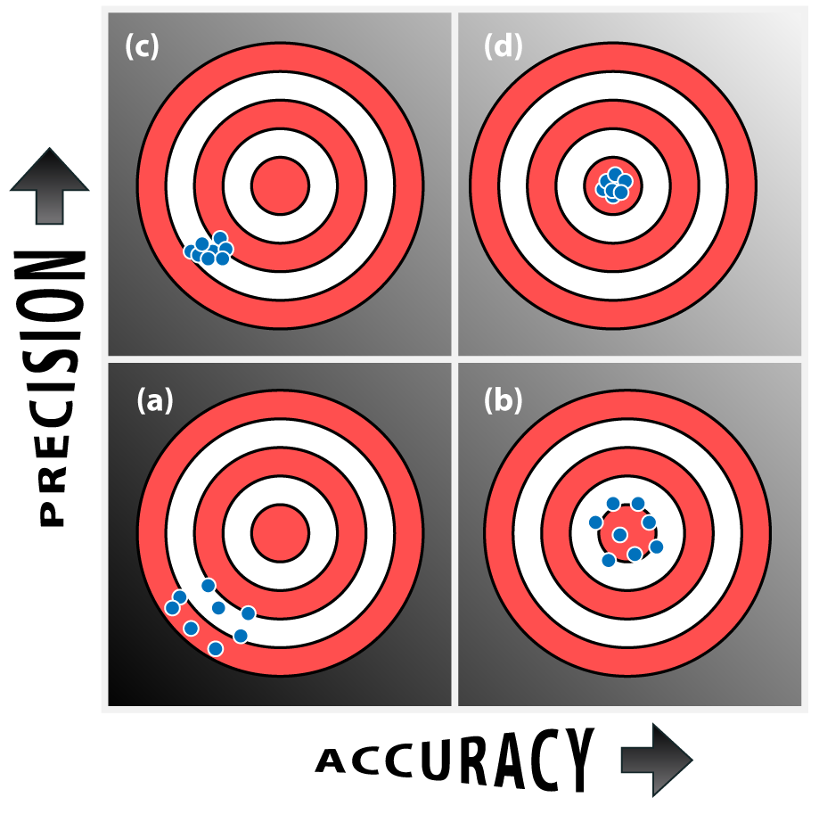
Accuracy vs. Precission

Slide 27
Measurement: Possible Errors
Statistical error: an error introduced due to measurement principle or noise that is often Gaussian in nature, with mean at the true measurement value. HOW TO HANDLE?
Systematic error: an error introduced due to de-adjustment of the sensor.

Slide 28
Measurement: Possible Errors
Statistical error: an error introduced due to measurement principle or noise that is often Gaussian in nature, with mean at the true measurement value. This error can be averaged out by taking multiple measurement of the same physical phenomenon
Systematic error: an error introduced due to de-adjustment of the sensor. This error can not be averaged out. HOW TO HANLDE?

Slide 29
Measurement: Possible Errors
Statistical error: an error introduced due to measurement principle or noise that is often Gaussian in nature, with mean at the true measurement value. This error can be averaged out by taking multiple measurement of the same physical phenomenon
Systematic error: an error introduced due to de-adjustment of the sensor. This error can not be averaged out, but the system can be (re)calibrated.

Slide 30
Reasons for measurement errors
Internal: Measurement circuity
E.g. measurement noise due to thermal movement of atoms or the avalanche effect in semiconductors
Externally induced noise, e.g. 50 Hz signal overlay
External physical phenomena influencing measurement
Misconception

Slide 31
Classical Sensor Systems
How do we measure classically?
By precisely controlling the measurement conditions!
For a specific problem we identify the physical phenomenon by:
Direct measurement
Controlled placement
Controlled environment
This is the appropriate way for settings where precision is more important than cost
Notes:
direct measurement: we select appropriate sensors that give direct indication of the physical phenomenom
controlled placement: we place the sensors at the exact location where we need to measure the physical phenomenon
Controlled environment: we control the measurement environment so that the measurement can be taken without external influences such as noise

Slide 32
Measurement
Outcome of a measurement process: a normalized sensor value plus a unit
Normalized: a mutually agreed standard defines units for the values of certain physical phenomena. In Germany: DIN 1313
SI Unit system (Système International d’Unités) defines
metre (m) :SI unit of length
second (s) :SI unit of time
kilogram (kg) :SI unit of mass
ampere (A) :SI unit of electric current
degree kelvin (K) :SI unit of thermodynamic temperature
candela (cd) :SI unit of luminous intensity
Mole (mol): SI unit of chemical substrate
All other units are derived

Slide 33
Traditional Measurement Process
DIN 1319
Define Measurement task and measurement unit
Specify ALL measurement conditions exactly (conditions of the measurement object, environment
Select a measurement device
Calibrate a measurement device
Specify the measurement process precisely
Take the measurement(s)
Calculate noise influence, systematic measurement error
Calculate overall measurement result and quantitative error margin

Slide 34

Measurement
Traditional Measurement works in a closed system approach
For complex detection difficult:
Activity ← reasoning← concluded phenomenon ← classification ← feature reduction ← feature extraction← normalization← detection← measured physical phenomenon
Requires a lot of knowledge about the measurement process (see slide before) before starting
Simpler in Context recognition: Activity ← classification ← feature extraction ← measurements While classification is just trained
Activity
Measurabel Phenomenon (Sensor on Machine)

Slide 35
Example of a Recognition Process
Sensor data are often an interpretation of an electrical property (e.g. resistance,) which can be measured by an electrical parameter e.g. voltage
1
Voltage
Over time
0
Feature extraction: Avg over time & threshold
000000111000011111100101010111000111
Classification: Assign to a class
Quiet.................loud...........average..........

Slide 36
Pattern Recognition in general
Here normalized value seem not to play any role
What do you think, is this the case? And if so, why?
Sensor
Data
Class
Detection (Transducer /Sensor)
Feature
Extraction & Reduction
Features
Classification
Further Abstraction
...
...

Slide 37


Sensor and Context
Context c transforms signal s to s’ at state x c($x$,s)=s’
Context Recognition is learning c’⁻¹ so that c’⁻¹(s,s’)=$\hat{x}$
Typical $x$ is only nominal and c is no function and c⁻¹ does not exist, so why even try to model it???
Context c with hidden state
Sensor
Beacon/ Reflector
$$x$$
External Energy Source

Slide 38

Detection Chain
Ubicomp: Assignments correlated / learned
Activity
Physical Pheno-menon
Detection
Classification
Activity
Classical Measurement methods: Each step analytically modelled
Phenomenon
(e.g. Context Value)
Activity
Physical Pheno-menon
Detection
Feature Extraction & Reduction
Normalization
Classification
Reasoning
Activity

Slide 39
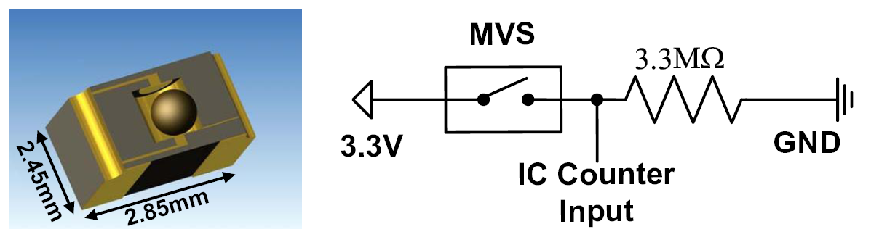
Unconventional Sensors
Notes:
This context awareness and novel form of HCI is based on sensors.
What we used in the Retail Store Application are special types of sensors as the one you see here, that is a extreme high sensitive movement sensor system with almost 0 energy consumption that we develop togehter with Prof. Weber from the IPE (Institut für Prozessdatenverarbeitung und Elektronik) from the Helmholtz Part.
Now we have sensors and we want to build context aware systems out of it. How do we do this?

Slide 40
Measurement in the 21st century
„A set of observations that reduce uncertainty where the result is expressed as a quantity” Douglas Hubbard: "How to Measure Anything", Wiley (2007)
Result of a measurement: value, mean, other statistical values e.g. standard deviation
In this sense, a good guess may not be worse than a bad measurement

Slide 41
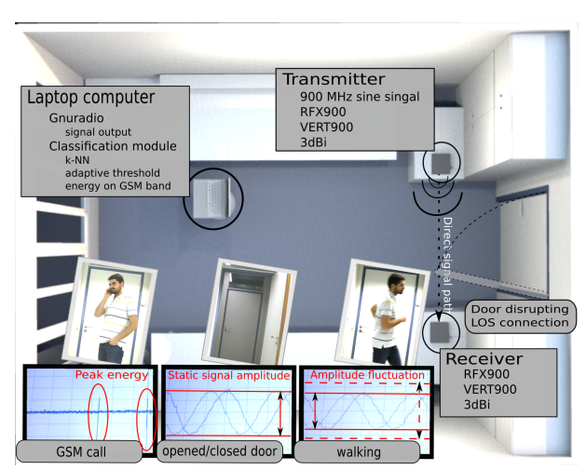
Activity Recognition Using RF Signals

